Slide 1
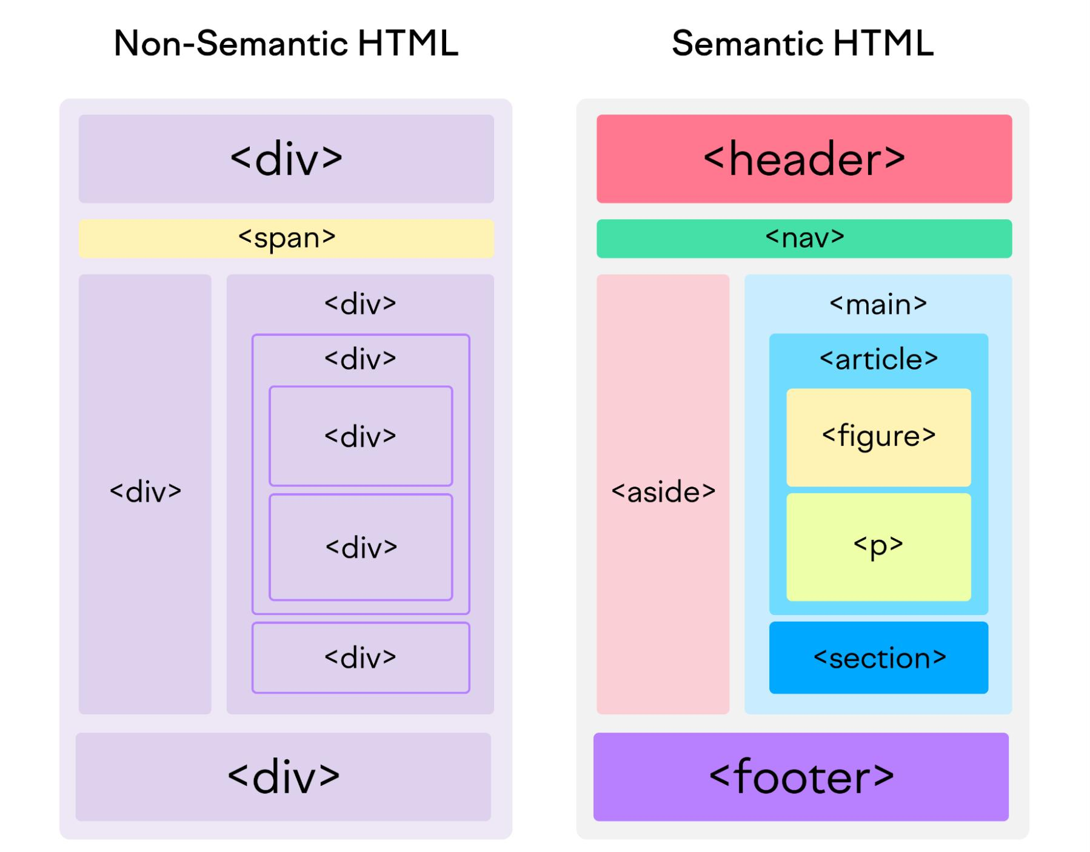
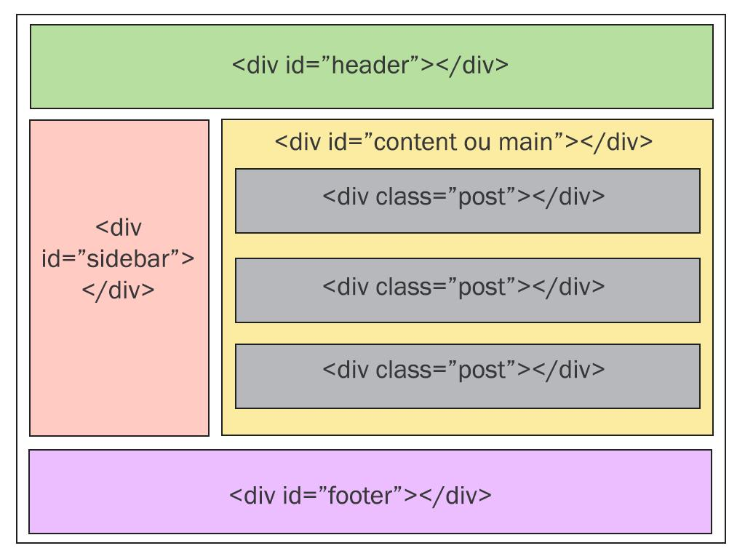
Commonly used HTML tag
For page structure
<header></header>
<nav></nav>
<main></main>
<footer></footer>
<div></div> (universal box)

Slide 2
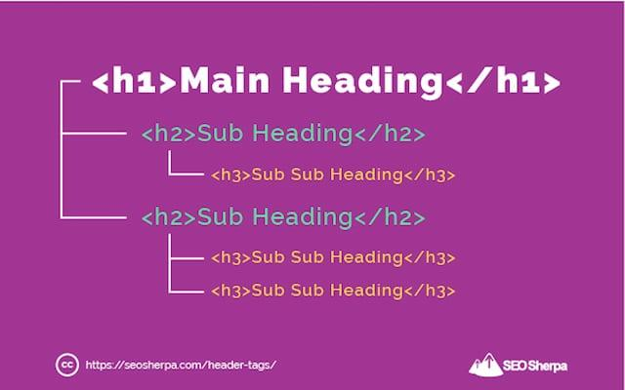
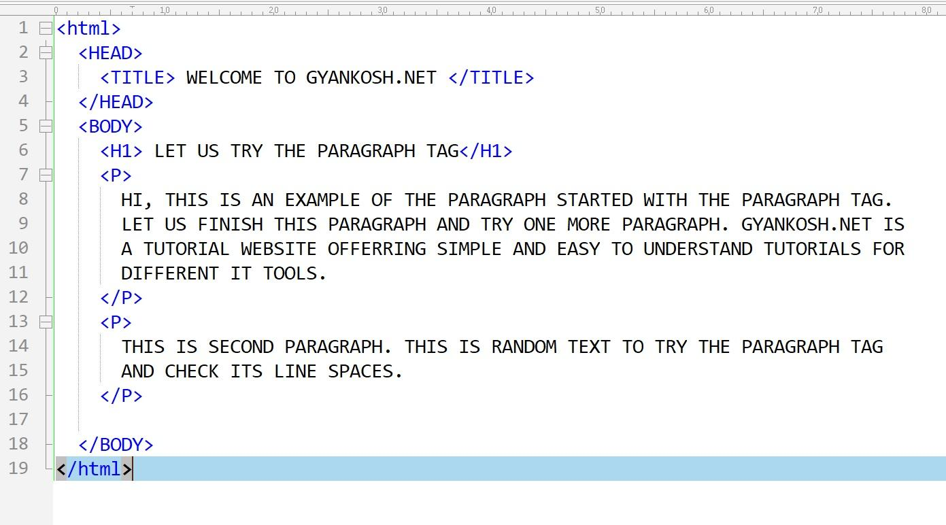
Commonly used HTML tag
For text
<h1></h1> (up to h6,going smaller)
<p></p>
<span></span>
<strong></strong>

Slide 3
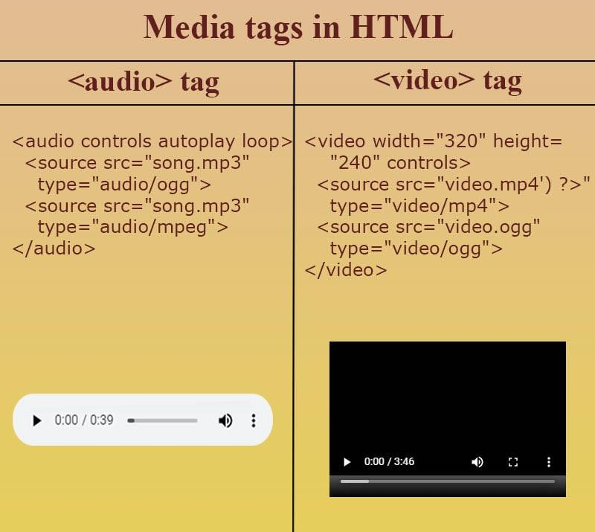
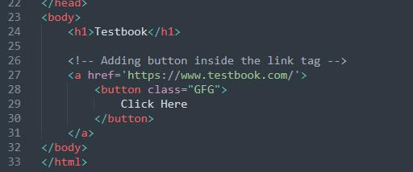
Commonly used HTML tag
For links and media
<a></a> (for links)
<img/>
<video></video>

Slide 4
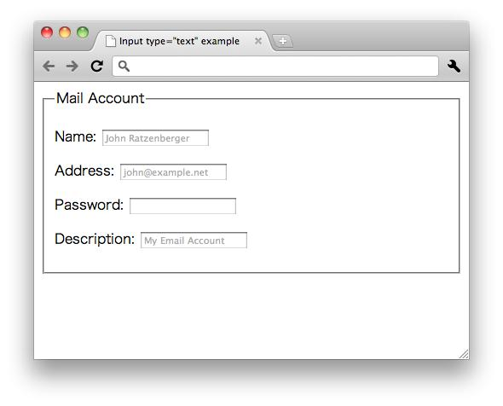
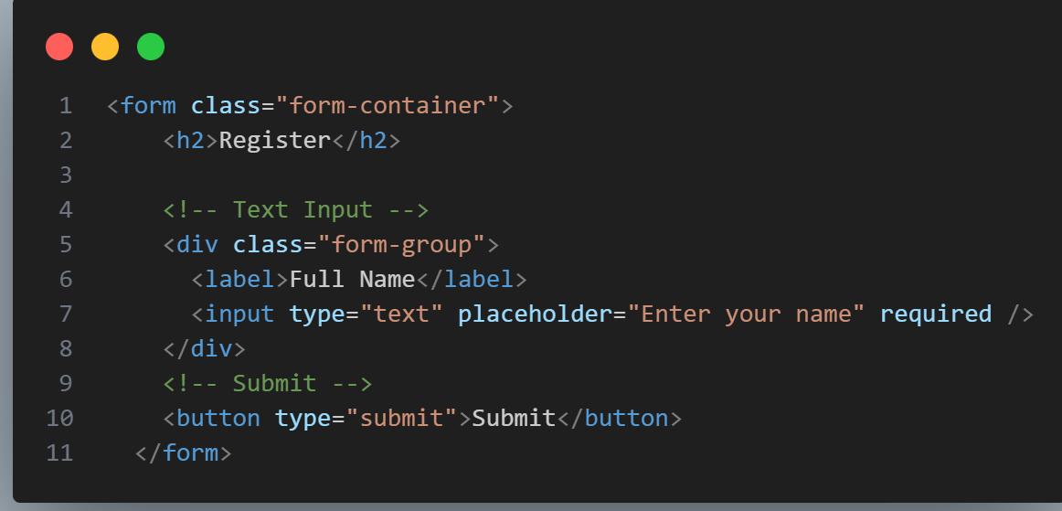
Commonly used HTML tag
For form
<form></form> (opening tag for forms)
<input/> (there are alot of types, refer to google for it
<label></label>

Slide 5
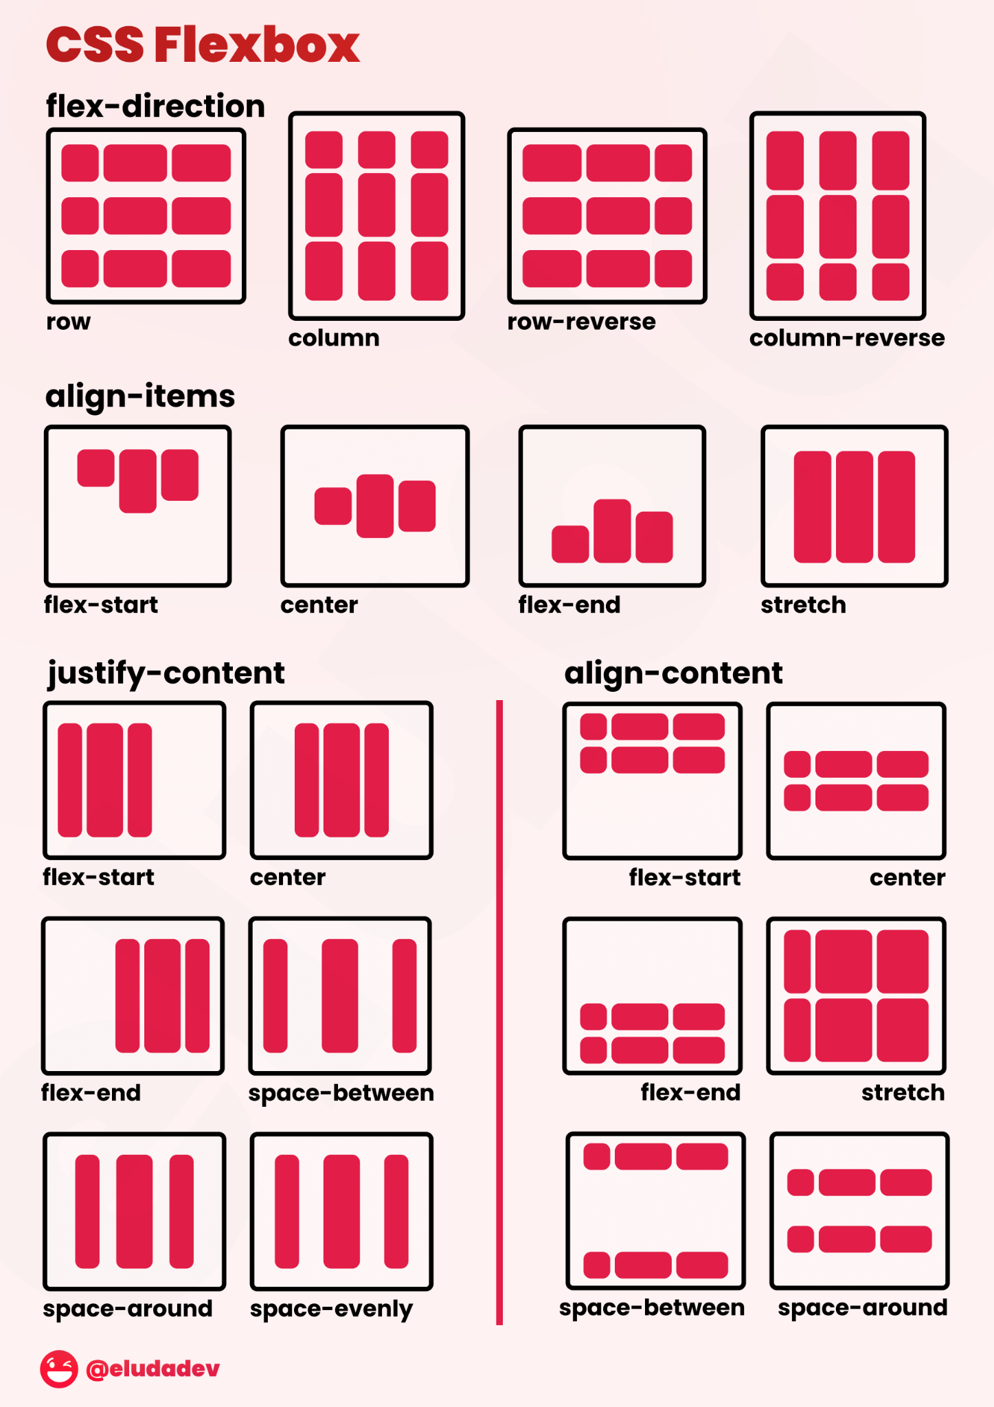
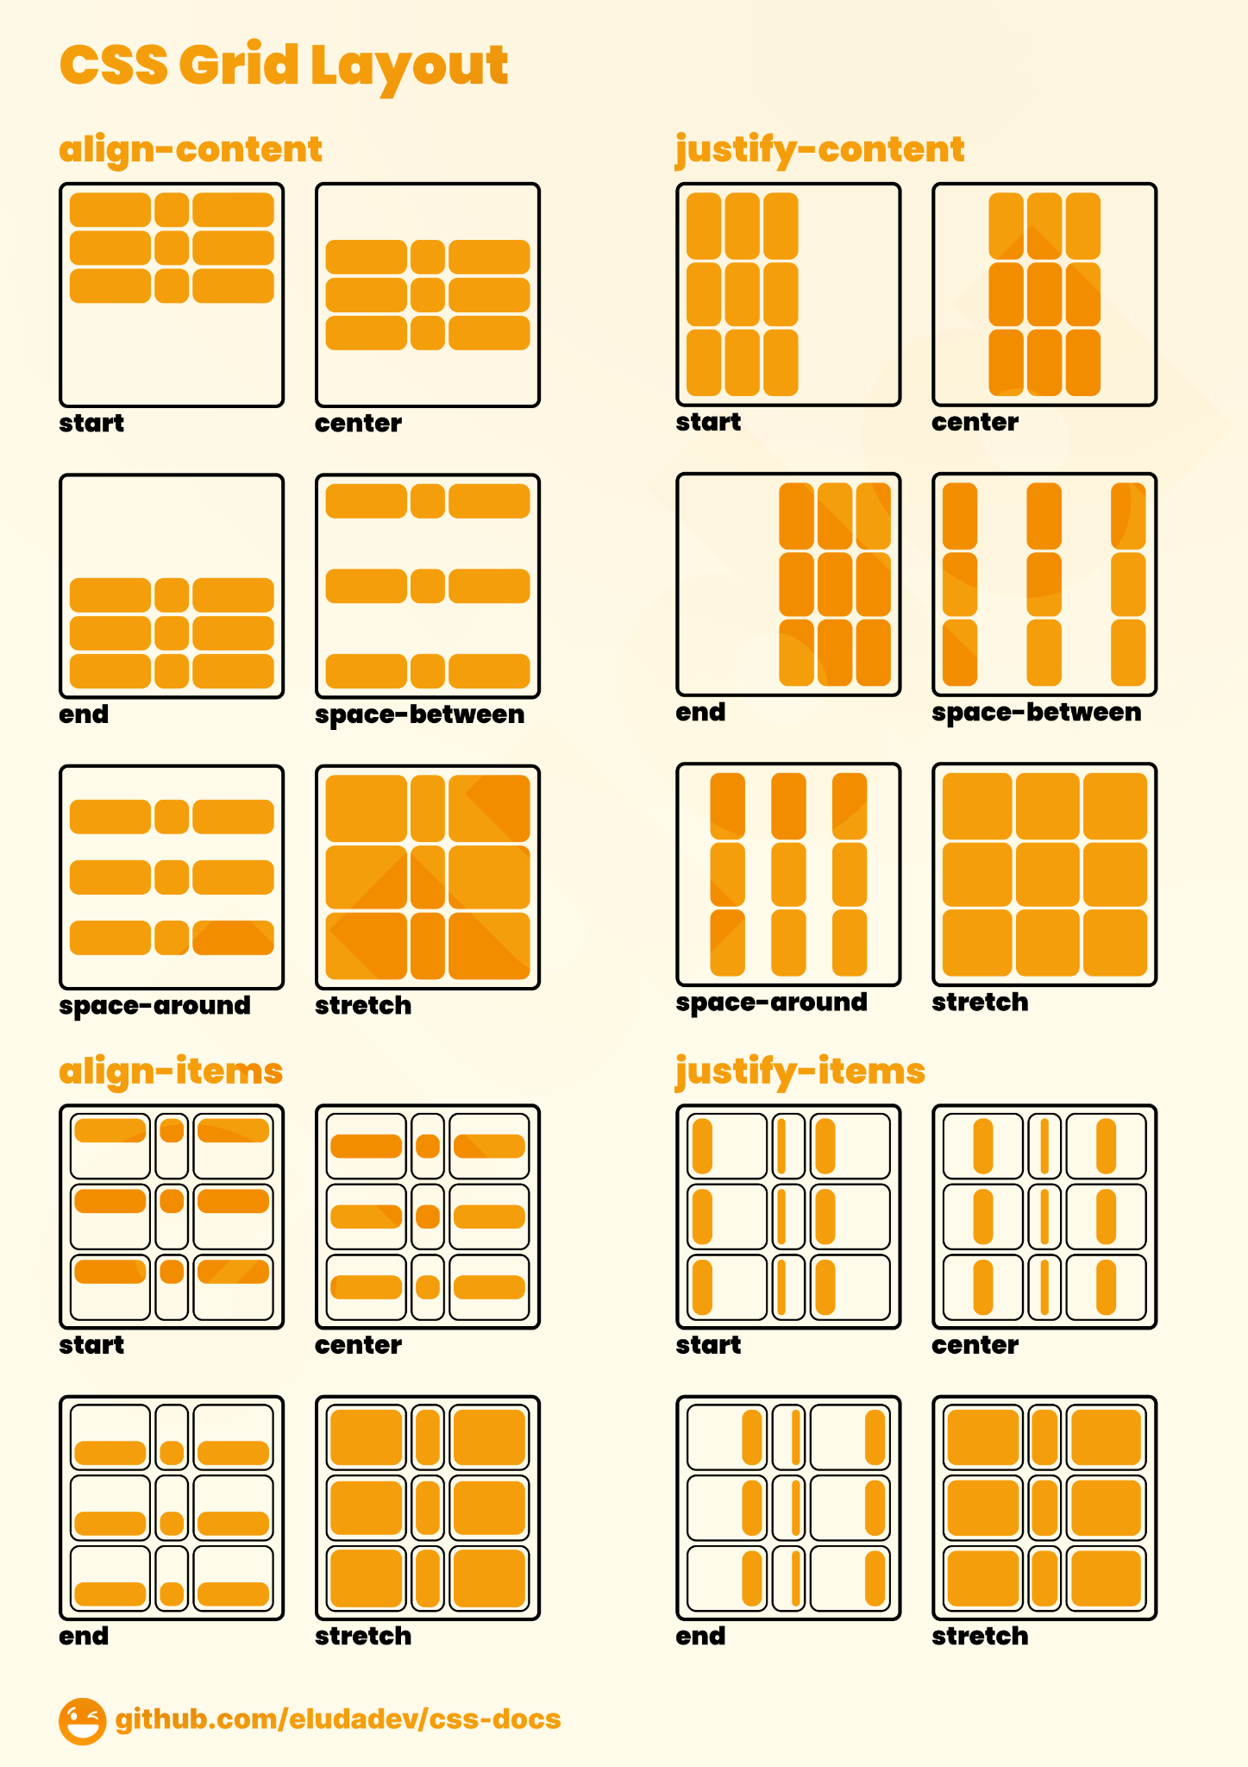
Commonly used CSS properties
For layout (Most important)
display: flex
display: grid
justify-content
align-items
Gap
Flexbox is mostly used for controlling a webpage layout

Slide 6
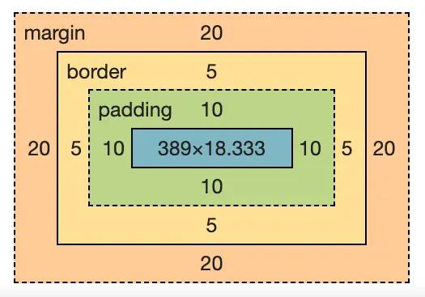
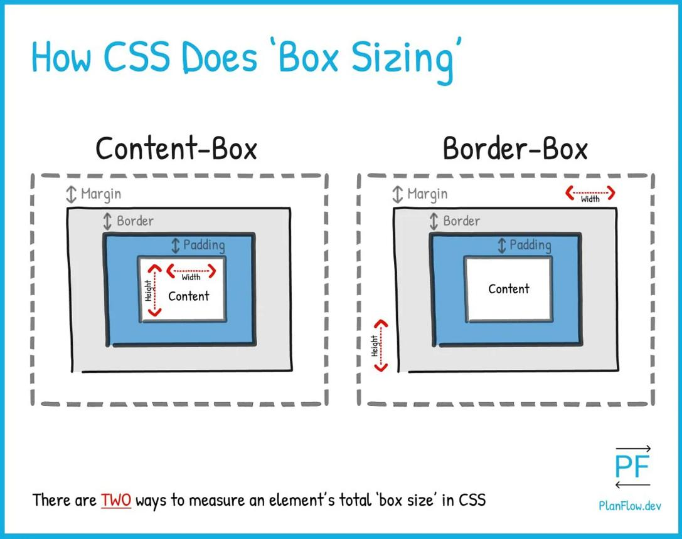
Commonly used CSS properties
For box model
margin
padding
width
height
Box-sizing: border-box
These apply to all HTML tag

Slide 7
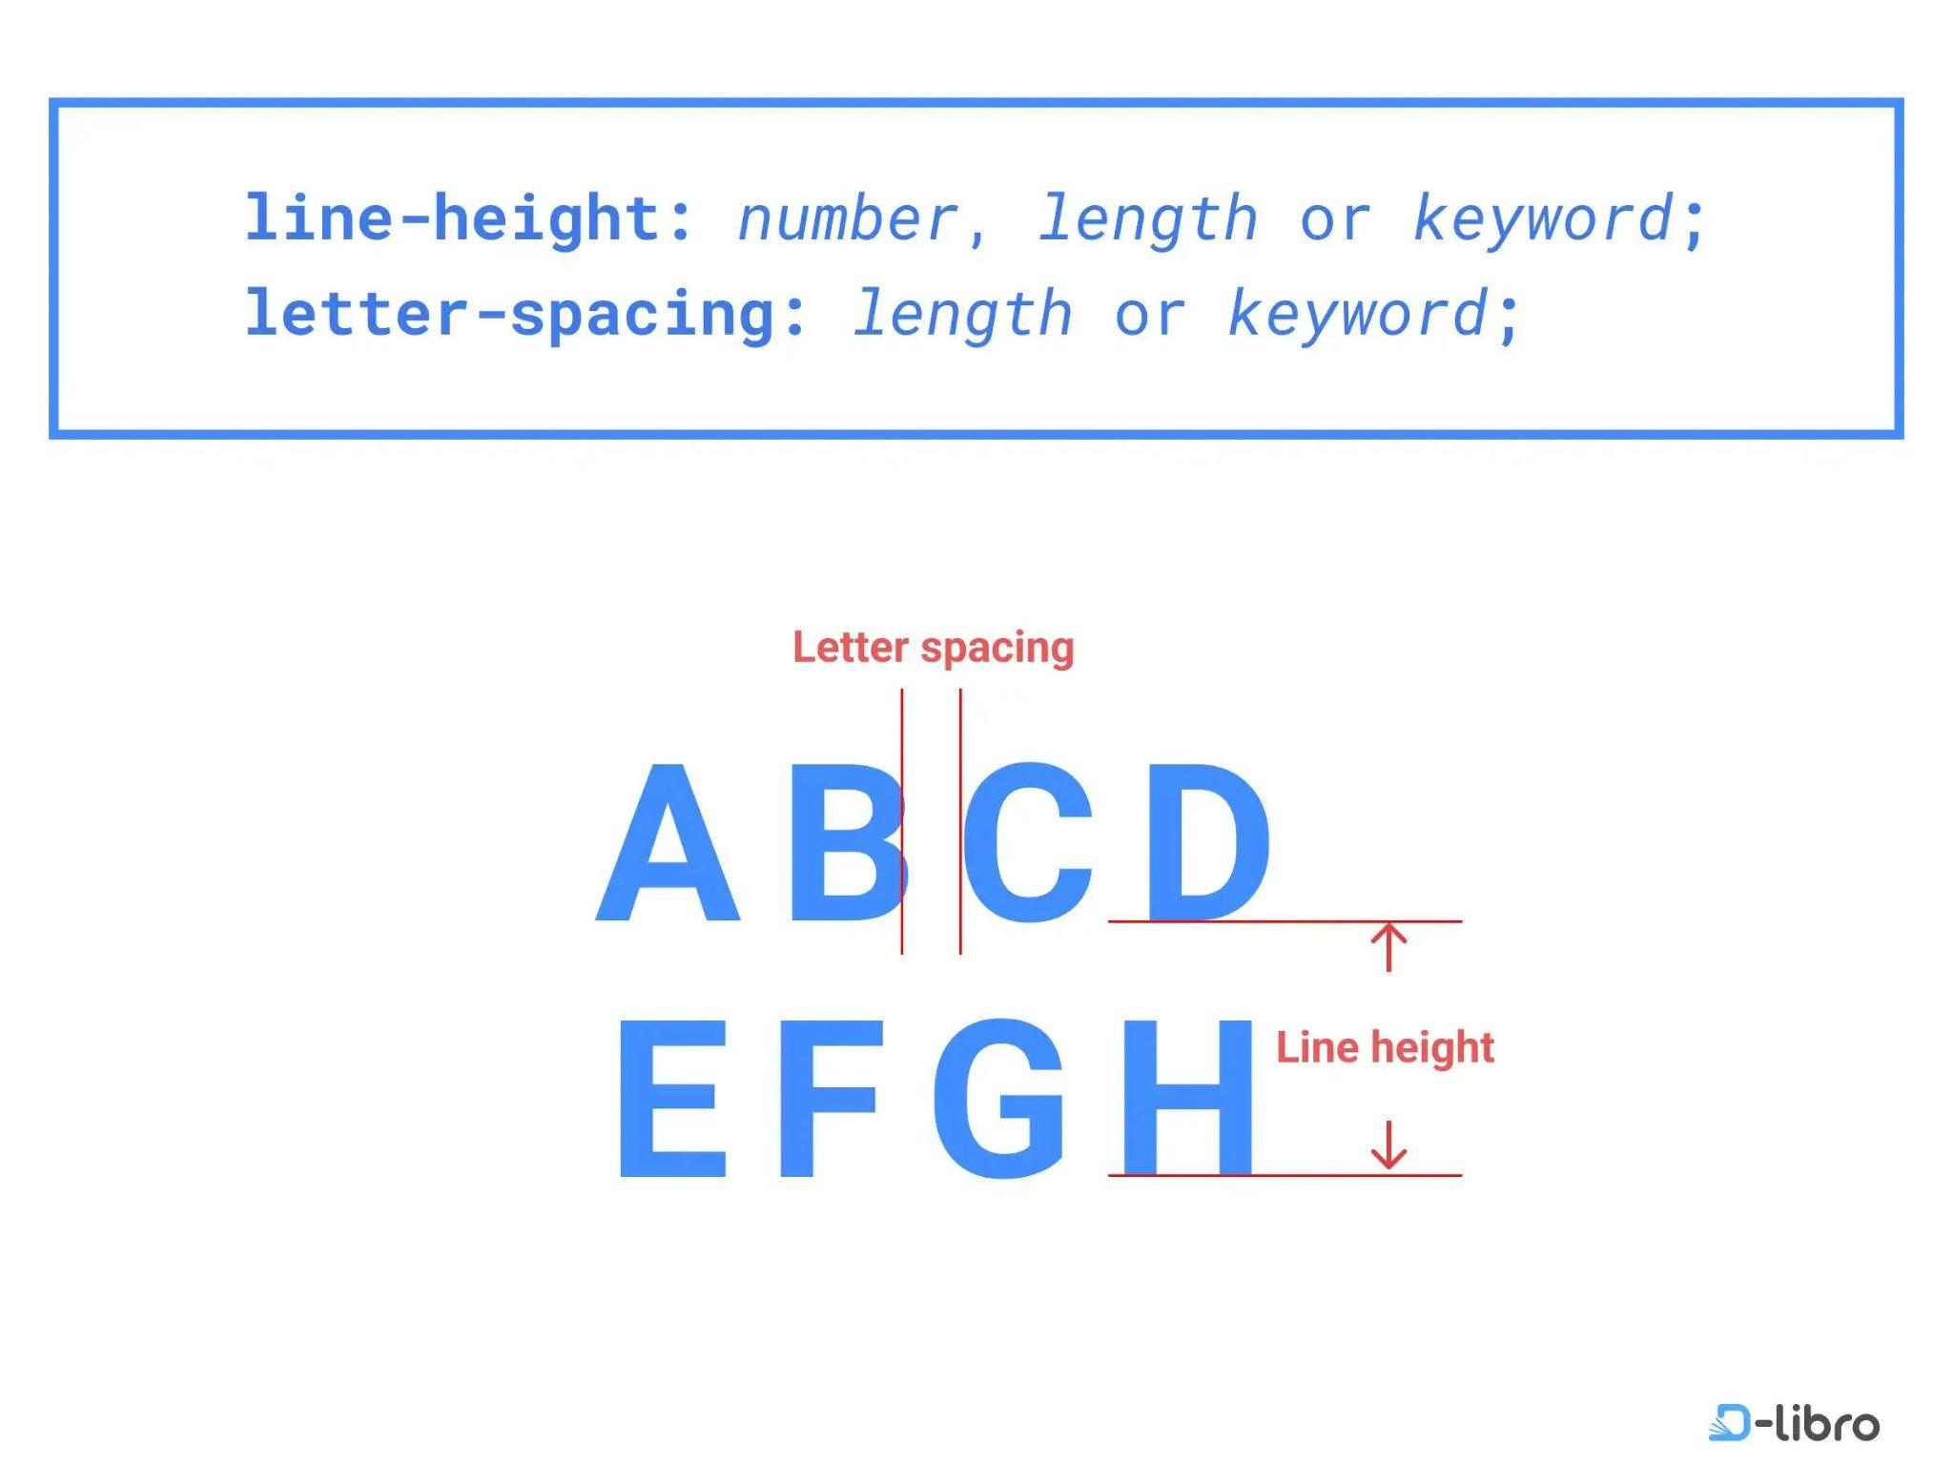
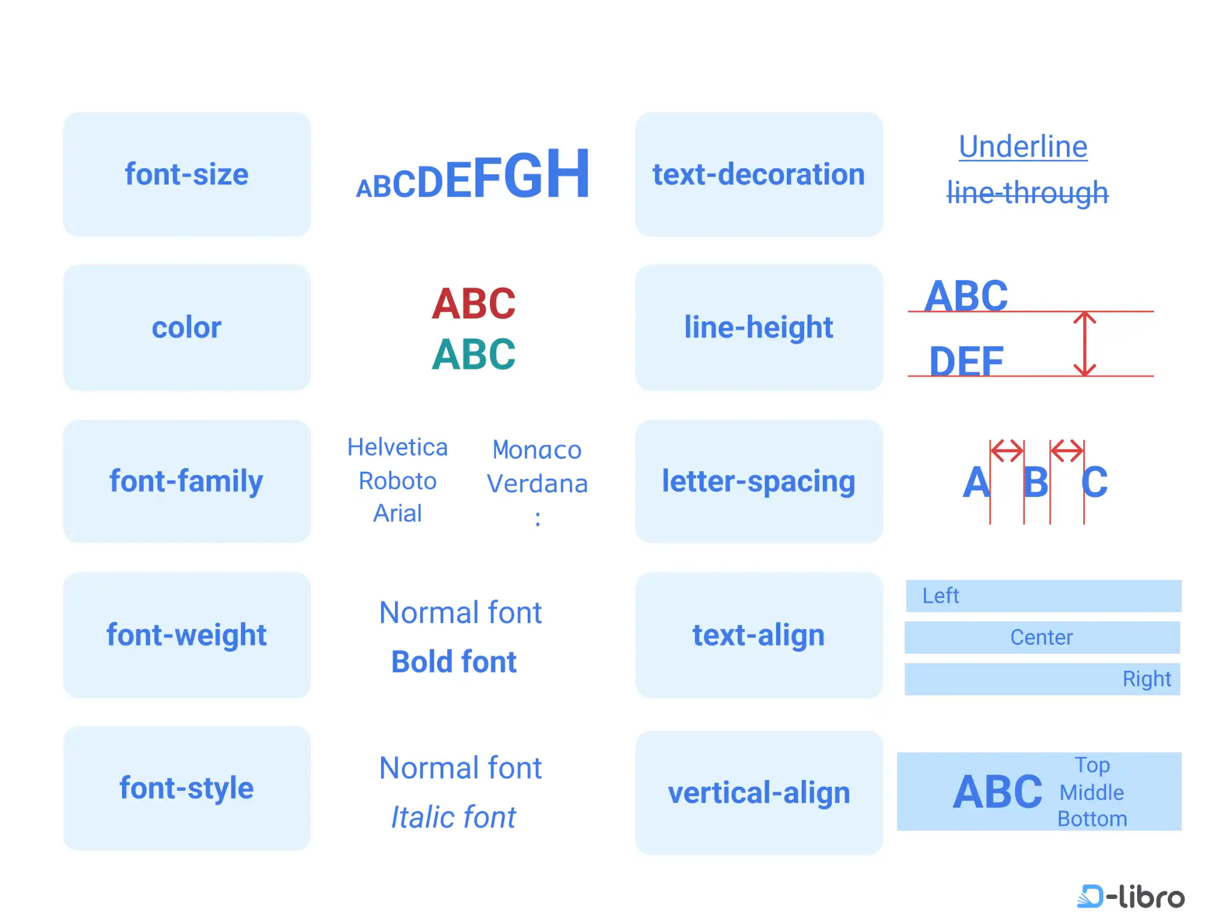
Commonly used CSS properties
For text
font-size
Font-weight (thickness of text)
font-family
color
text-align
color

Slide 8
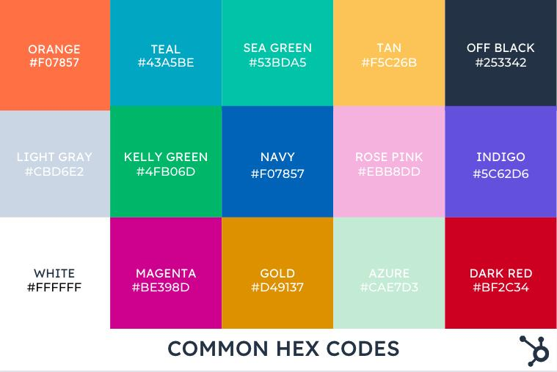
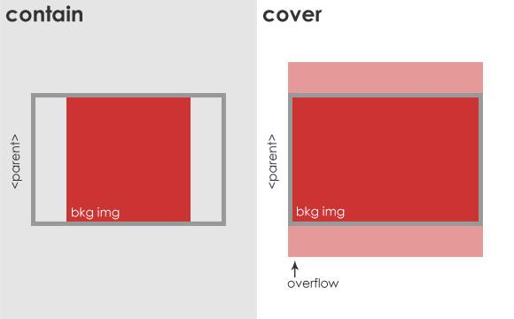
Commonly used CSS properties
For background and colors
Color (for text, commonly mistaken for background-color)
Background-color
background-image
background-size: cover

Slide 9
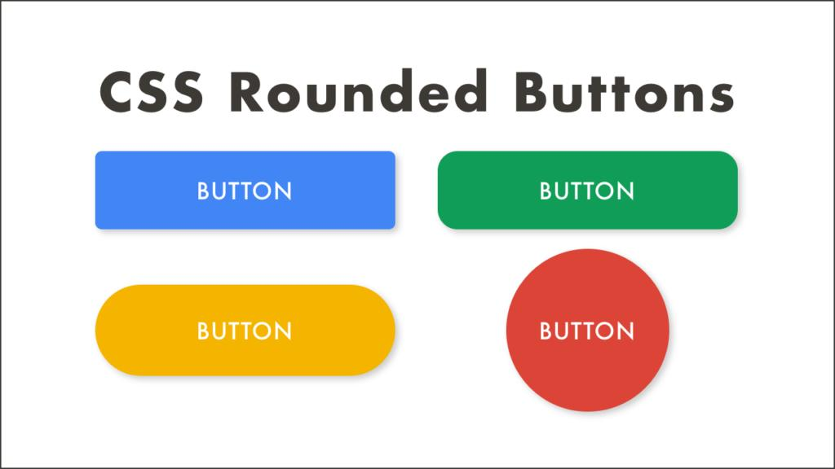
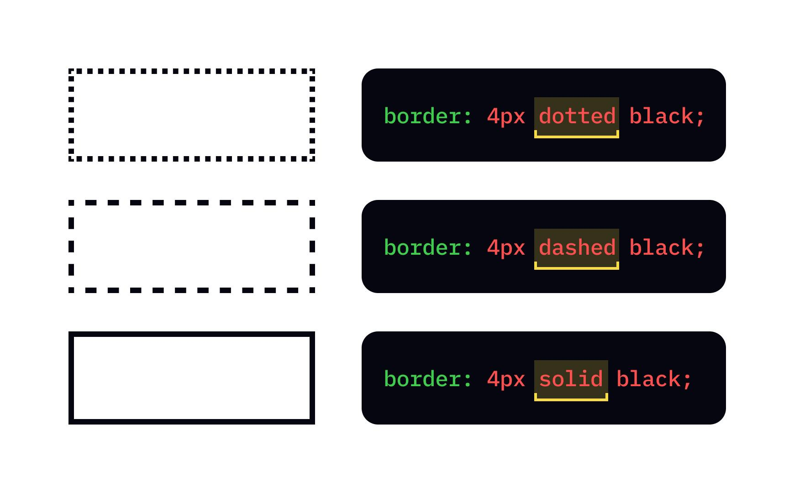
Commonly used CSS properties
For borders & effects
border
border-radius
box-shadow
transition

